Slide 1


Annette Dahlke
National Key Broker Account Executive
920-661-2312
adahlke@goldenrule.com
Health Plans for Individuals and Families
Underwritten by Golden Rule Insurance Company

Slide 2

Key Differentiators
Large National Footprint
UnitedHealthOne Product Options
Network Size & Discounts
UW/Placement Rate Advantage
Geo-targeting our Best Markets
Estore - Resources

Slide 3


Strength in Numbers
UnitedHealth Group insures over 70 Million Americans
UnitedHealth Care serves over 26 Million customers
United touches 1 in 3 Americans
Voted one of Fortune Magazines Top 3 Most Admired Health Care Companies in America
Notes:
Since merging with Unitedhealthcare, nearly 5 years ago, Golden Rule has remained steadfast in a vision of financially sound growth. With Over 70 million Enterprise members, 28 million of those directly insured with United Healthcare, we touch nearly 1 in 3 Americans. We have been voted by Fortune Magazine as a Most admired HealthCare company 3 years in a row.

Slide 4
Gen 25 Product States
Alabama
Arizona
Arkansas
DC
Delaware
Florida
Illinois
Indiana
Iowa
Louisiana
Maryland
Michigan
Mississippi
Missouri
Nebraska
North Carolina
Ohio
Oklahoma
Pennsylvania
South Carolina
Tennessee
Texas
Virginia
West Virginia
Wisconsin
WA
MT
ND
OR
MN
WI
NY
ID
SD
MI
CT
WY
PA
NE
IA
OH
MD
DE
NV
IL
IN
WV
UT
CO
VA
DC
CA
KS
MO
KY
NC
AZ
OK
TN
NM
AR
SC
MS
AL
GA
TX
LA
FL
Gen 24-25 State
Non Gen State
PacifiCare State
No Product Available
Notes:
Platinum products are available in 19 states and the District of Columbia. All other states will have the standard plans that you already sell.

Slide 5

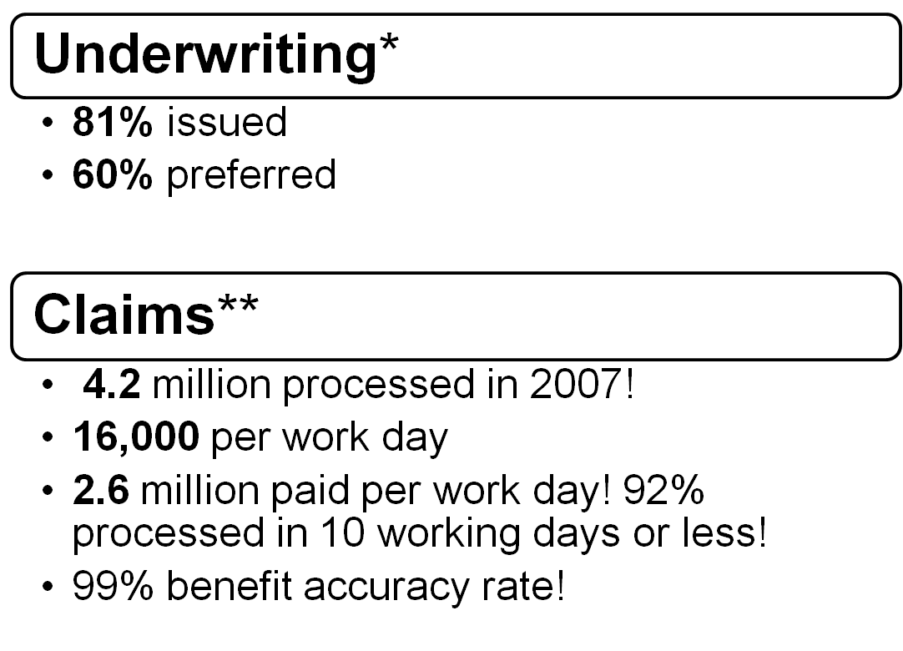
Commitment to Quality
81% issued
61% preferred
5.5 million processed in 2008!
21,000 claims paid per work day
$3.7 million paid per work day! 94%
94% processed in 10 working days or less!
99.5 % benefit accuracy rate!
* Actual 2008 health underwriting results
** Actual health claims results 2008

Slide 6

Product
Portfolio
Notes:
For every 100 applicants, 82 are made an offer.
Out of the 82, 86% accept the offer.
Therefore, 71% of applicants take coverage with Golden Rule!
6

Slide 7
Lower New Business Rates
Age
Reduced rates for those age 45 and over
Deductible
Reduced rates on deductibles $5000 and greater
Area
Reduced rates in Alabama, Missouri, Mississippi, and Oklahoma
Up to 5% less
2.5% less
5-15% less
Notes:
Not only do qualified Preferred I Rate Class applicants benefit from new lower rates but rates have also been reduced for those new applicants in the following categories:
Applicants ages 45 and over
Most plans with deductibles of $5000 or greater
Plus new applicants in select areas also will see 5-15% lower rates

Slide 8
Lower New Business Rates
State Level Rate Changes
Alabama – 10%
Michigan – 2%
Missouri – 5%
Mississippi – 5%
Oklahoma – 15%
Age Rate Changes
Age 45 -2%
Age 46 -3.5%
Ages 47+ -5%
Plan Specific Rate Changes
HSA Plans -2.5% (excluding $1,250/$2,500 and $7,000 70/30)
Non HSA Deductibles 5000 and higher -2.5%

Slide 9

www.goldenrule.com/estore
Copay plans*
  Copay SelectSM – benefit-rich with unlimited doctor office copays
  Copay SaverSM - our most affordable copay plan
Health Savings Account (HSA) plans - Qualified
  HSA 100® - our comprehensive HSA
  HSA 70SM - our most affordable HSA plan
High Deductible plans - Non-Qualified
  Plan 100®- our simplest plan to understand, 100% coinsurance
  Plan 80SM – similar to the Plan 100, premium savings of 80/20 coinsurance
  Saver 80SM - our most affordable plan
Dental- Vision- Short Term MedicalSM
*Not available in AK
Notes:
(CLICK) We continue to lead the emerging HSA market!
(CLICK) The simplicity of our High Deductible plans continues to remain popular with both brokers and clients.
(CLICK) We continue to gain unprecedented momentum in the copay market
(CLICK) And something not to be overlooked is our short term medical

Slide 10
Copay SelectSM
$500, $1,000, $1,500, $2,500, $3,500, $5,000, $7,500, $10,000
Deductible Choices
Coinsurance Out-of-Pocket
 | (3 month wait) $35 office copay 80% lab, x-ray, immunizations (no wait) 80% Mam, Pap, PSA
$35 Doctor Office Copay (Regardless of deductible!) | Copay is unlimited!! General Practitioner, Specialist Covers history and exam
Coinsurance Choices
100%
80%
70%
$0
$3,000
$5,000
Preventive Care
(No Deductible, No Annual Max)
*
Notes:
HSA 100 now offers 4 standardized deductibles
Instead of a variable set of deductibles that change each year based on the annual Cost of Living Adjustment for HSA Qualified plans
HSA 100 now offers 4 deductible choices that won’t have to be adjusted each year
Preventive care on HSA 100 is no longer subject to the deductible, and has no annual max
The months from the effective date preventive office visits are covered after a $35 office copay and x-ray, lab and immunizations are covered at 100% with no deductible.
There is no waiting period for mam, pap, & psa
*In 2007 less than 2% of Golden Rule Policy Holders with an annual Rx maximum exceeded $3,000 in Rx expenses

Slide 11
Copay SelectSM
Preventive Care – No Deductible Applies No Maximum!
Covered Preventive Service | No Waiting Period | 3 Month Waiting Period
Mammogram | X
Pap Smear | X
P.S.A. Testing | X
Well Dr. Office Visit |  | X
Child Immunizations |  | X
X-ray and Lab |  | X

Slide 12
Copay SelectSM
$3000 max with an option to remove.
Prescription Drugs
Tier 1 - $15 copay, no deductible
Tier 2 – 4 combined $200 deduct
Tier 2 - $35 copay, Tier 3 - $65, Tier 4 – 25%
Tier 1 = More than half of covered Rx
Hydrocodone Tramadol Lisinopril
Metformin Prednisone Atenolol
Tier 4 = Less than 1% of covered Rx
In 2008 less than 2% of Golden Rule Policy Holders with an annual Rx maximum exceeded $3,000 in Rx expenses.
Notes:
Copay Select Tier 1 Rx remain the same
More than half of covered Rx fall into Tier with Rx deductible and only a $15 copay
Tier 2
Tier 3
Tier 4 is simply a 25% copay
Less than 1% of all cover Rx fall into tier 4
FYI (Hydrocodone & Tramadol treats pain, Lisinopril & Atenolol treats high blood pressure, Metformin treats diabetes, Prednisone treats asthma and allergies)

Slide 13
Copay SaverSM
Premiums for Copay SaverSM are significantly less because coverage is not provided for some outpatient services, such as:
  Outpatient doctor visits beyond office copays
  Brand name prescriptions - $15 generic RX card is included
  Diagnostic testing, x-ray & lab (must be performed within 14 days of surgery or confinement) unless otherwise noted.
20% - 40% Less
$1,500, $2,500, $5,000, $7,500, $10,000
Changes to Coinsurance | $6,000
Deductible Choices
Doctor Office Visit
(2 per person, per year)
(Upgradable to 4 visits)
Preventive $35 Copay
(3 month wait)
Notes:
Considering the ECONOMY consumers are lowering their costs in every area of their budget
Some are going to take a chance and see how long they can manage without medical coverage
But here’s a plan that offers a significantly lower price point, without eliminating routine coverage
Typically 20-40% less (than Copay Select)
Copay Saver offer much broader coverage than other limited benefit plans, it covers the big stuff
Hospitalization, out patient surgery, MRI, Cat Scans, Chemotherapy, Dialysis
Plus this plan comes with either a 3 or $5million lifetime max

Slide 14
HSA 100®
Single Deductible Choices
$1,250, $2,500, $3,000, $3,500, $5,000
Family Deductible Choices
$2,500, $5,000, $6,000, $7,000, $10,000
Preventive Care
(No Deductible, No Annual Max)
(3 month wait) $35 office copay
100% lab, x-ray, immunizations
(no wait) 100% Mam, Pap, PSA
$3000 annual maximum*
Preferred price card included
Prescription Drugs
Notes:
HSA 100 now offers 4 standardized deductibles
Instead of a variable set of deductibles that change each year based on the annual Cost of Living Adjustment for HSA Qualified plans
HSA 100 now offers 4 deductible choices that won’t have to be adjusted each year
Preventive care on HSA 100 is no longer subject to the deductible, and has no annual max
The months from the effective date preventive office visits are covered after a $35 office copay and x-ray, lab and immunizations are covered at 100% with no deductible.
There is no waiting period for mam, pap, & psa
*In 2008 less than 2% of Golden Rule Policy Holders with an annual Rx maximum exceeded $3,000 in Rx expenses

Slide 15
HSA 70SM
Cost Savings
Up to 20% Less Than HSA 100
(3 month wait) $35 office copay
70% lab, x-ray, immunizations
(no wait) 70% Mam, Pap, PSA
Preventive Care
(No Deductible, No Annual Max)
Prescription Drugs
$3000 annual maximum*
Preferred price card included
Coinsurance
30%
Coinsurance Out-of-Pocket
Varies By Deductible
Deductible Choices
Same As HSA 100
Notes:
Explain
Coinsurance out of pocket varies by deductible
Page 9 of brochure shows coinsurance out of pocket (varies to stay under Federal max OoP for qualified plan)

Slide 16
HSA 100 and 70
Preventive Care – No Deductible Applies No Maximum!
Covered Preventive Service | No Waiting Period | 3 Month Waiting Period
Mammogram | X
Pap Smear | X
P.S.A. Testing | X
Well Dr. Office Visit |  | X
Child Immunizations |  | X
X-ray and Lab |  | X

Slide 17

OptumHealthBankSM
Convenience…
Health plan and savings account administered together
2% interest
Prepaid debit card, checkbook or online bill payment options
Online banking makes lump sum deposits easier…
Notes:
(click) We offer a turn-key sales solution with our H.S.A. plans. When using our administrator, OptumHealth Bank, the health plan and the savings account are administered together; We administer the health plan, OptumHealth Bank administers the savings account.
OptumHealth Bank is a wholly owned subsidiary of United Health Group. They have a focus on health care banking and are the nation’s leading provider of HSA services.
We can draft your client’s premium and HSA contribution at the same time, and put the money in the savings account for them.
(click) OptumHealth is currently crediting a 2% interest rate and your clients funds start earning interest immediately.
(click) If your clients need to withdraw funds from their account to pay for qualified medical expenses they can do so by using either the prepaid debit card, the checkbook feature, or if they prefer online bill payment that is also an option.
(click) Online banking is convenient with OptumHeatlhBank. Your clients can make lump sum deposits anytime throughout the year, subject to IRS limitations. Also, a monthly maintenance will come directly from the client’s h.s.a. account and this fee will be debited on the statements the insured receives each month from OptumHealth.

Slide 18

High Deductible Plans – Plan 100®
Plan deductibles*
  $1,500, $2,500, $5,000, $7,500, $10,000
  Two calendar-year deductibles per family
100% Coinsurance after deductible**
  Doctor office visits
  Prescriptions
  Preventive care***
  Inpatient/Outpatient services
*Not all deductibles available in all states.
** of covered expenses
***Limited benefit. See product brochure for detailed plan description
Notes:
(Click) The plan 100 features a very simple plan design. After the per person plan deductible is met, the plan pays 100% of covered expensed for the rest of the calendar year.
And with our non-qualified high deductible plans, there is a maximum of only two deductibles to be met per calendar year for the family deductible to be satisfied.
(click) Your client will choose his or her deductible from as low as $1500 up to $10,000 and once the deductible is satisfied the plan pays 100% for covered expenses, such things as:
Doctor office visits
Prescription coverage
Preventive care
In-hospital patient services
Out-patient services

Slide 19


High Deductible Plans – Plan 80/Saver 80
Plan 80
  15-25% less than Plan 100®
  80/20 to $15,000 coinsurance
Saver 80
  30-40% less premium than Plan 100®
  80/20 to $15,000 coinsurance
  Limited coverage
  Coverage for major expenses
Notes:
(Click) The Plan 80 is very similar to the Plan 100 but it is priced approximately 15-25% lower. The difference in coverage is in the coinsurance. The Plan 80 has an 80% coinsurance instead of 100% as in the Plan100.
And with a stop loss of $15,000 your client’s portion after the deductible will be $3,000 per person while Golden Rule’s is $12,000.
(Click) The Saver 80, again is the most affordable plan we offer and is priced approximately 30-40% less than the Plan 100.
It features the same coinsurance as the Plan 80, again, 80/20 to $15,000.
Because the premium is lower the plan has more limited coverage
Outpatient doctor visits are not covered
Outpatient prescriptions are also not covered
But Coverage is provided for the more costly medical expenses, like:
o/p surgery, hemodialysis, chemotherapy, and MRI’S and CATscans.

Slide 20
Best Selling Street Plans - Nationally
 | Plan | Deductible
¹ | Copay Select | 80/20 $2,500
² | Copay Select | 70/30 $5,000
³ | Copay Select | 80/20 $5,000
⁴ | HSA100 | $2,500 / $5,000
⁵ | Plan 100SM | $2,500
⁶ | Copay SelectSM | 70 / 30 $2,500
⁷ | Copay Select | 100% $2,500
⁸ | Copay Select | 80/20 $1,500
⁹ | HSA 100 | $5,000 /$10,000
¹⁰ | Copay Select | 100% $5,000
Notes:
The most popular deductible on the Copay Select is the $2500. HSA 100’s best seller is the $5,800. Plan 100 $2500 is another best seller as well.

Slide 21
UnitedHealth One Plans Options
Accident
Benefit
Maternity
24 Month Rate Guarantee
Dental
Vision
Notes:
UnitedHealthcares Strong nationwide network is a key reason why we are able to provide such great benefits at an affordable price.
21

Slide 22
Dental and Vision
Dental
Rider
Stand Alone
Vision
Rider to Dental
Rider to Medical
*Available as health insurance rider or stand-alone policy, depending on state; product availability varies by state.
Notes:
You’ll find the dental coverage is available in many states either as stand-alone coverage, or as a rider to a UnitedHealthOne health plan.
And the vision coverage is often offered as a rider to either dental or health.
And you can start marketing these plans right away.
Let’s take a look at the plans and their benefits.

Slide 23
Dental and Vision States
State | Dental Rider | Dental StandAlone | Vision Rider | Vision to Dental Alone |  | State | Dental Rider | Dental Stand Alone | Vision Rider | Vision to Dental Alone
AL | X | X |  | X |  | MI | X | X |  | X
AR | X | X |  | X |  | MO | X | X |  | X
AZ | X | X |  | X |  | MS | X | X |  | X
CO | X | X | X | X |  | NE | X | X |  | X
CT | X | X | X | X |  | NM | X | X | X | X
DC | X | X |  | X |  | OH | X | X |  | X
DE | X | X | X | X |  | OK | X | X |  | X
FL | X | X |  | X |  | PA | X
IA | X | X |  | X |  | SC | X | X |  | X
IL | X |  |  |  |  | SD | X |  | X
IN | X | X |  | X |  | TN | X
KY | X |  | X |  |  | TX |  | X |  | X
KS | X | X | X | X |  | WV | X | X |  | X
LA | X | X | X | X |  | WY | X |  | X
MD | X

Slide 24

UnitedHealthcare Dental
Dental PremierSM
  Available statewide
  Richer out of network benefit
  Higher premium than Value
Dental ValueSM
  Lower premium than Premier
  Available only in strongest network areas
  Lower out of network benefit
Notes:
Premier is often purchased if:
Dental Value is not available
The prospects dentist is out of network and they are not will to switch to an in-network dentist

Slide 25
Dental Services | ValueSM | PremiereSM
No deductible, no wait
Preventive
Routine exams, routine x-rays, cleaning, fluoride treatment (under age 16), sealants, space maintainers (under age 13)
Deductible, then 80% (6 month wait)
Basic
Routine extractions, simple fillings
Deductible, then 50% (12 month wait)
Major
Root canals, crowns, veneers, dentures
Deductible
$50 per person, per calendar year (Max 3)
Max Benefit
$1,000 per person, per calendar year

Slide 26

UnitedHealthOne Vision Option
Individual Vision Insurance that will Open Your Eyes
Administered by Spectera, Inc.
Golden Rule Insurance Company, a UnitedHealthcare company, is the underwriter of the vision plans marketed under the UnitedHealthOne brand.
Notes:
And as a rider option to both our stand-alone dental plans and our health insurance plans, you’ll want to open your eyes to the UnitedHealthOne vision option.
With vision and dental you now have a complete family of health insurance products to offer your individual clients.
Let’s take a look at how this vision option can be the right choice for your clients.

Slide 27

Focus on the Value
24,000 Network Providers*
  Private practice and retail chain providers
Service | Your Client Pays | In-Network GRI Pays | Out-of-Network GRI Pays
Eye Exam | $10 Copay | 100% | Up to $40
Frames | $25 Copay | 100% | Up to $45
Single Vision Lens | $25 Copay | 100% | Up to $40
Bifocal Lens | $25 Copay | 100% | Up to $60
Tri/Lenticular Lens | $25 Copay | 100% | Up to $80
Contacts | $25 Copay | 100% | Up to $105
See brochure for coverage variations
* As of publication date
Notes:
And with over 24,000 vision care professionals in the network your clients will have the opportunity to take full advantage of the benefits.
After the insured’s copay, the vision plan pays 100% of the covered benefit, when using an in-network provider.

Slide 28

Plan Enhancements
Lifetime Maximum*
Can elect to have $5 million per person
Initial Rate Guarantee
12 month standard, 24 months optional
No Prescription Maximum
Eliminates $3,000 yearly prescription maximum.
* Not available in all states. See product brochure for detailed benefit options descriptions.
Notes:
(Click) Also available is the option to increase the Lifetime Maximum to 5 million dollars! This is great for your clients who want an increased available benefit. There’s a flat premium for this benefit whether or not it’s a single or family plan so you’ll definitely want to check that out when quoting the plans.
(Click) Our individual health insurance plans come standard with an initial 12month rate guarantee, for those clients who want a greater initial rate guarantee we have the 24 month enhancement available.
(click) And this enhancement allows your client to eliminate the $3,000 yearly prescription maximum on their plan, if applicable.

Slide 29
Preventive Care Benefits Package*
No Deductible
Covered Service Your Client Pays
Well Dr. Office Visit | $35
Mammogram | $0
Pap Smear | $0
P.S.A. Testing | $0
Child Immunizations | $0
X-ray and Lab | $0
No Coinsurance
No Waiting Period
No Annual Maximum
*Available with Plan 100, Plan 80, Saver 80, and Copay Saver
Notes:
Preventive Care is an option that can be added to all plans except the HSA plans and the Copay Select. As you may recall, similar coverage is already included in the base coverage for those plans.
When choosing this option your clients will benefit from just a
(click) $35 Office Visit Copay when visiting the Dr. for their wellness visit
(click) Mammograms, Pap Smears, PSA Testing, Immunizations, and Xray and Lab
are all covered at 100% and
(Click) are not subject to a deductible
(click) Coinsurance,
(click) waiting period or
(click) yearly maximum.

Slide 30

Maternity Option*
Available with all plans except HSAs.
Per pregnancy benefit
No deductible
Insured pays 20%
Pays graduated benefit
  Years 1&2 = $2,500 covered ($2,000 paid)
  Years 3&4 = $5,000 covered ($4,000 paid)
  Years 5+ = $7,500 covered ($6,000 paid)
*Not available in all states. See product brochure for detailed benefit options.
Notes:
(Click) Our maternity benefit is available with all plans with the exception of the two HSA plans…
This benefit can easily help cover the costs associated with routine pregnancy or delivery, and it’s monthly premium is $109.
This benefit enables the client to:
Pay only 20%
While Golden Rule pays 80% with NO deductible. (click)
It has a graded benefit with a maximum of $7,500 in covered expenses.

Slide 31

Term Life & ADD
Brochure Insert
Term Life
  $50,000
  $100,000
  $150,000
Accidental Death
  $50,000
Eligibility
  Primary Insured/Covered Spouse
  Ages 18-64
  Coverage per person
  Terminates at age 65
Notes:
New Enhanced Term Life Option
Quickly & easily replaces lost group life coverage
Increase compensation
Improve persistency
Multiple lines with one application
No additional underwriting

Slide 32

Preferred Price Card
Discounts provided at thousands of participating pharmacies
Included with all health plan (except Copay plans)
Offers drug discounts*
Average savings of 20%**
Walgreen’s Kroger Meijer Eckerd Target CVS
*Discount program, not insurance.
** Data provided by Golden Rule’s Managed Care and Product Mgt. Dept. 2008
Notes:
Most of our health plans for individuals and families include a Preferred price card which offers prescription drug discounts. When clients use any of the thousands of participating pharmacies, they will enjoy savings averaging about 20% on their prescription drugs.

Slide 33

Enhanced Supplemental Accident – New!
Helps reduce out-of-pocket!
Applies to:
Deductible
Co-insurance
Copays
Saver Plan outpatient
Notes:
Next, let’s look at our New Enhanced Supplemental Accident Option.
Supplemental Accident is an outstanding benefit for families with young children or those who purchase a high deductible health plan.
UnitedHealthOne plans have just made a good benefit even better. Enhanced Supplemental Accident now applies, and helps satisfy your clients health plan out-of-pocket expenses such as deductibles, coinsurance and copays.
That’s right. Previously our Supplemental Accident coverage paid for your clients accident related expenses, but did not apply to the plan deductible and coinsurance. New Enhanced Supplemental Accident will apply to your clients deductible and coinsurance potentially reducing their overall out-of-pocket exposure.
Furthermore, this option has been improved by increasing benefit amounts as high as $10,000.
Also, your clients who purchase a lower cost Saver Plan, like Copay Saver should consider this option. Since many outpatient expenses typically not covered by Saver Plans would be paid under the Enhance Supplemental Accident benefit!
What’s the cost of this added protection?

Slide 34
Enhanced Supplemental Accident Benefit
Brochure Insert
Benefit Amounts
  $500
  $1,000
  $2,500
  $5,000
  $10,000
Eligibility
  90 days of an injury
  Credited towards deductible/coinsurance
  Optional Benefit – just a check mark
Notes:
New Enhanced Term Life Option
Quickly & easily replaces lost group life coverage
Increase compensation
Improve persistency
Multiple lines with one application
No additional underwriting

Slide 35
Enhanced Supplemental Accident
Enhanced Supplemental Accident
 | $500 | $1,000 | $2,500 | $5,000 | $10,000
Single | $12 | $16 | $20 | $25 | $30
Family | $21 | $28 | $35 | $43.75 | $52.50
About $1.15 per day!
Notes:
It may be less than you think.
When applying for the $2500 coverage amount, an entire family can be covered by this option for a little more than $1 per day.
First dollar accident coverage, per person, per accident with benefit amounts up to $10000.
Quote this option for your next client with children, or considering a high deductible health plan.

Slide 36
Deductible Credit
Help boost client retention with deductible credit!
Deductible
not met
= 20% Deductible
Reduction
Up to
50%
Deductible
Calendar Year 1
$5,000
Calendar Year 2
$4,000
Calendar Year 3
$3,000
Calendar Year 4
$2,500
Notes:
Here’s how it works.
If an insured individual does not meet their plan deductible, the following year their deductible is reduced by 20% of the original amount.
For example:
An individual with a $5000 deductible who, in their first year, does not satisfy their deductible would receive a reduced deductible of $4000 in year two.
If the $4000 deductible is not met in year two, it will be reduced to $3000 for year three.
The maximum Deductible Credit can accumulate to 50% of the original deductible.
So, if the year three deductible is unmet, then year four the deductible will be reduced to $2500
The insured’s deductible will remain at this reduced level until either their deductible is met or coverage is terminated.
If the reduced deductible is met, it will reset the following year to the initial deductible amount, in this example $5000, and Deductible Credit can begin to accumulate again.

Slide 37
Deductible Credits
Deductible is reduced by 20% per year if it not satisfied in the prior calendar year.
  Maximum deductible credit / reduction is 50%
  Plan must be in force / active at least 6 months in a calendar year to be eligible for credit in the following year.
  Credit given on a per person basis (except on family HSA plans)
  If deductible is met it is reset to the original level the following year, and deductible credit can be earned again.
* For covered expenses, not including copays. See product brochure for detailed description

Slide 38



UnitedHealthcare Choice Plus (available in most states)
Broad Expansive Network
Choice of Network Providers
Provider discounts up to 45%*
www.goldenrule.com
Notes:
(Click) A common denominator between our Health Plans for Individuals and Families and Short Term Medical is our Preferred Network
In most markets we’re now utilizing the UnitedHealthcare Choice Plus network.
There are currently over 4,800 hospitals coast to coast and over half a million physicians and other health care professionals participating.
This is great for a couple of reasons…
(click) It gives your client his or her choice of network providers at all times!
(Click) And, we have a network discount up to 45% for the repricing of claims.
(Click) You can access the network very easily by going to the Goldenrule website and clicking on “find a doctor”
Saying this is one thing, seeing it in action is another…

Slide 39

Preferred Network
UnitedHealthcare Choice Plus (available in most states)
■ Broad, expansive national network
  • 4,900 Hospitals
  • 580,000 Physicians
■ Choice of network providers, even while traveling
■ Often offers significant provider discounts**
  • Network discounts up to 45% for claims repricing
Access to preferred network directory:
www.goldenrule.com...(click on) Networks
**Discounts vary by provider, geographic location, and service provided

Slide 40
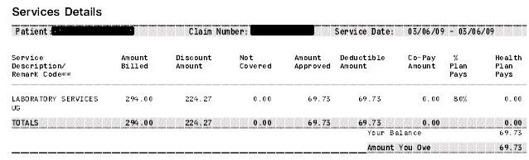
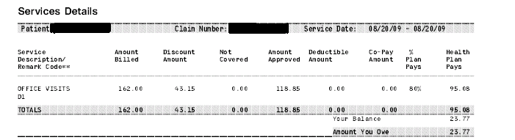
Provider Network Discounts*
Amount billed
$294.00
Discount:
224.27
76%
Amount billed
$162.00
Discount:
43.15
27%
*Discounts vary by provider, geographic location, and service provided
Notes:
What you’re seeing now is an actual EOB belonging to a Golden Rule employee. This insured has coverage using the United Healthcare Choice Plus Network…
This EOB is for lab work. Originally it was billed at $294. However, before he had to pay anything, the bill was submitted to the network for repricing. It received a 76% discount, so he only owed $69.73.
Here’s another EOB and this one is for a doctor’s office visit. It was billed at $162. However, when this claim was submitted to the network for repricing, it was discounted by 27% reducing the actual amount owed to just $118.85!
These EOBs are not unusual. Again, because of the size and strength of the UnitedHealthcare Choice Plus network, clients are realizing significant discounts when it comes to claims repricing.

Slide 41

Underwriting

Slide 42

Who’s Eligible?
Individuals to age 64.5
Dependents to age 25
Residents of the United States
Notes:
You can offer UnitedHealth One inividual plans to individuals under age 64.5 and dependents can remain on a plan up to age 25. To apply for health coverage, your client must have been a resident of the United States for the last 12 months.

Slide 43

Why Rider Instead of Rate Up?
Why Rider?
  Accommodate Pre-Ex.
  Premium Doesn’t Change.
What’s involved?
  No more than 4 on an individual.
  No more than 6 per family.
What’s new? Rate up of 10%
Notes:
To help provide coverage to those people with preexisting conditions, UnitedHealthOne may offer coverage with an exclusionary rider. We do not rateup the premium based on medical conditions, and will not place more than 4 riders on an individual and no more than 6 per family.

Slide 44
Adult Rating Classes
Preferred I – 7% less than Preferred II
Meets preferred underwriting guidelines and had previous health insurance coverage in last 63 days*
Preferred II – 10% less than Standard I
Meets preferred underwriting guidelines and did not have previous health insurance coverage in last 63 days*
Standard I – 25% less than Standard II
Meets standard I build guidelines with minor health concerns
Standard II
Meets Standard II build guidelines with more complex health history.*
Notes:
When quoting adults you will have 4 rate classed to choose from.
Over 60% of applicants are rated preferred and it is the premium with lowest rates.
Newly added, is Preferred I which is priced approximately 7% lower than the previous Preferred rate class. Those who qualify will fall under the preferred underwriting guidelines and will have had insurance coverage in the past 63 days.
Preferred II is for those clients who still qualify for preferred status but did not have previous health insurance coverage, Preferred II is approximately 10% lower than Standard I rates.
Standard I will be for those clients with relatively minor medical history and who fit into the Standard I height and weight charts. Standard I is approximately 25% less premium than Standard II.
Standard II is for those clients with more complex health history and who’s build guidelines fall into the Standard II category.
Children up to age 18 are rated as standard.

Slide 45

Preexisting Conditions
Preexisting conditions will not be covered during the first 12 months* after an individual becomes a covered person.
Note: This exclusion does not apply to conditions which are both:
Fully disclosed to Golden Rule on the application
Not excluded or limited by our underwriters
Unacceptable conditions**
  Hypertension/high cholesterol/tobacco use
  Individuals contemplating hospitalization or surgery
  Undiagnosed ailments or symptoms
*Varies by state.
**This is only a summary. Check Broker Guide for further details.
Notes:
(CLICK) In most states, the definition for Pre-existing states that a condition will not be covered during the first 12 months after an individual becomes a covered person.
However… this pre-existing exclusion will not apply to conditions which are both:
Fully disclosed to Golden Rule on the application
and
which are not excluded or limited by our underwriters
Of course, there are some medical conditions that present increased risk and that Golden Rule is generally unwilling to even consider.
(CLICK) Combined high blood pressure and high cholesterol along with tobacco use is one such risk.
The combination of these three things together can cause a stroke or heart attack much sooner than if the person did not smoke, or didn’t have high cholesterol in combination with high blood pressure. So a person having three cardio risks such as these would be a decline.
Bottom line… we take into consideration factors that could cause a person a much higher morbidity rate if more than one condition is present.
(CLICK) Individuals contemplating surgery or hospitalization is typically another auto decline. We usually require that any anticipated surgeries or hospitalization be completed before coverage can be considered.
(CLICK) Undiagnosed ailments or symptoms indicating potentially serious conditions are also not accepted.
An example might be someone who has been routinely experiencing chest pains but has not yet sought diagnosis…

Slide 46

Common Declines*
Congestive Heart Failure
Diabetes
Emphysema
Heart Attack
Rheumatoid arthritis
Stroke
Coronary artery disease/ bypass/ angioplasty
This is only a summary. Check the Broker Guide for further details.
Notes:
As well, some diagnosed conditions have also been identified as declines.
Some of the more common diagnoses for declines are:
(Click)
Congestive heart failure
Diabetes
Emphysema
Heart Attack
Rheumatoid arthritis
Stroke
Coronary artery disease, or by-pass, or angioplasty

Slide 47
Clearance Periods*
Atrial fibrillation – 2 years
Cancer – depends on type
Colon cancer – 5 years
Prostate cancer – 2 years
Epilepsy – 1 year since last seizure
Hyperthyroid – 6 months
Gastric Bypass – 5 years and stable weight for at least 12 months
This is only a summary. Check the Broker Guide for further details.
Notes:
And then there are some conditions that first require a clearance period to even be considered. Guidelines for clearance periods were developed by associating the potential future risk with the condition.
If a person has had surgery… what is the potential for complications occurring.. or even for relapse?
A clearance period is simply the period of time that a client must typically be both treatment and symptom free for a particular diagnosis.
Here are some examples of clearance periods. When in doubt definitely check the Broker Guide as it provides several examples as well.

Slide 48

On-line Tools
48
www.goldenrule.com
It’s convenient!
Fast and efficient
Your own Golden Rule store

Slide 49


Ease of E-Store
E-Store features:
Online quoting
Application submission
Online tracking
Marketing material
Training access
More
www.goldenrulehealth.com/broker
Notes:
In fact E-store has many convenient features
(click) 1. In addition to Online quoting and application submission.
Quotes you prepare through E-Store will be archived so that you can go back and access them later when needed; …
(click) applications that get submitted online will be tracked so that you know their progress at all times.
3. There are also various links provided on your E-Store home page to help you navigate through E-Store and which help support your Golden Rule business.
For instance
You can check your current and past commission statements
Print any and all forms, brochures, applications, and marketing materials needed to write our plans
You can also download quoting software to your desktop
access the network link for searching preferred doctors and hospitals
(click) Access on-demand training from the broker training tab
And (click) much more!

Slide 50

Two Easy Ways
Preliminary Evaluations*
Call
  800-474-4467
E-store
Information needed:
Age and gender
Diagnosis and Date
Prescribed treatment
HBP readings
Height and weight
*Preliminary Evaluations are not a guarantee of coverage. Final decision is up to underwriting at time of application submission.
Notes:
And we welcome pre-evaluations so if you have a client with health considerations that you’re not sure about, allow us to do a pre-evaluation for you.
You can accomplish this two easy ways.
First by simply calling the broker service center. A trained representative is there to help you and has the resources available to get your answer while you’re on the phone.
And if you don’t have time to make that call or just prefer doing business online then log into your estore, access the services tab and when you click on “Preliminary Evaluation” you’ll be on your way. You’ll be given an online form which is simple to complete. Once you submit the preliminary evaluation form you’ll have your answer within 3 business hours.
To get your answers for you we’re going to need the following information:
the age and gender of your client
What the diagnosis is and when it was diagnosed
What treatment has been prescribed and if the client is on medications we’ll need to know the name of the medication and the dosage.
We’ll also need to know the height and weight of your client and if they’re a tobacco user.
We look forward to helping you out with your future preliminary evaluations.

Slide 51
Application
YOUR broker name and number are embedded to application. Information is secure – encrypted user i.d. and password. E-Signature by client.
Paper – faxed or mailed
Effective date of choice
Draft date of choice
Draft premium on submission
Policy goes to agent – client receives id cards. You can change this option to have the policy go to the client.
Initial Payment | Ongoing Payment | Ongoing Payment
Bank Draft | Monthly Bank Draft | Monthly Direct Billing ($10.00 fee)
Credit Card (Visa or MasterCard) | Quarterly Direct Bill ($10.00 fee)

Slide 52
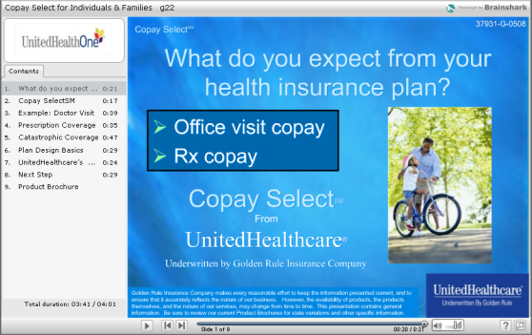
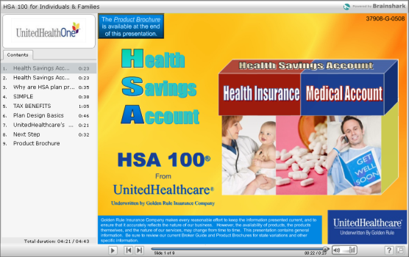



Client Presentations
Ever wish there was?
We Now Have Product Presentations for your Clients!
Copay SelectSM
HSA 100®
Dental
Short Term
Plan 100®

Slide 53
Placement Rate Advantage

Slide 54
#1 Placement in Industry
Top reasons for best in class placement:
  No signature or form needed for counter-offer
  60% qualify for our best rating class
  Quality brand and products
  Fast underwriting time service
  Riders vs. rate ups

Slide 55
Persistency by Product
55
Copay
12 Months = 59.4%
24 Months = 31.7%
HSA
12 Months = 77.1%
24 Months = 56.4%
Other
12 Months = 68.8%
24 Months = 46.1%

Slide 56
Persistency By Age
56
12 months
19 – 29 = 59.6%
30 – 34 = 66.8%
35 – 44 = 72.6%
45 – 54 = 76.1%
24 Months
19 – 29 = 32.8%
30 – 34 = 41.7%
35 – 44 = 50.4%
45 – 54 = 56.6%

Slide 57

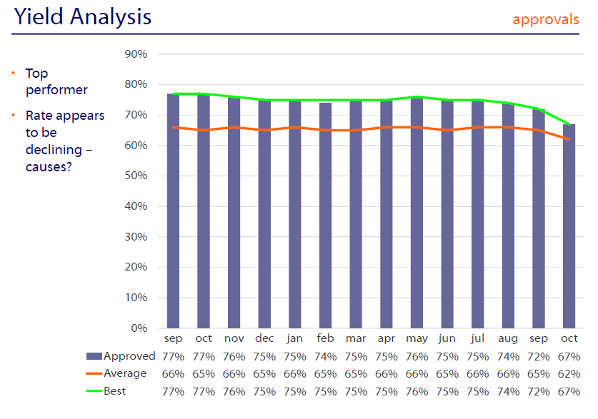
Approvals

Slide 58
Geo-targeting our Best Markets

Slide 59
Top 10 Cities
Scottsdale / Mesa (852) – AZ
Bradenton (342) – FL
Las Vegas (891) – NV
West Palm Beach area (334) – FL
Miami area (331 & 333) – FL
Ft. Myers (339-338) – FL
Altamonte Springs (327-328) – FL
Phoenix (850) – AZ
Alpharetta (300) – GA (Atlanta area)
Tampa area(336 & 338) - FL

Slide 60
Top 10 States
Florida
Texas
Arizona
Ohio
Pennsylvania
Missouri
Nevada
Wisconsin
Maryland
Georgia
Based on 2009 production

Slide 61
Dedicated Support Team For You!
Account Executive – Annette Dahlke
Keybroker Service Specialist- Laura Turley – keybroker@goldenrule.com
  Our best in class broker support helps separate us from the competition:
    Questions on pending applications
    Product discussion
    Quote requests
    Supply orders
    Underwriting guidance
    Quick response prescreens

Slide 62


What Sets Us Apart?
Our Commitment to You…
■ Strong Financial Rating
■ UnitedHealthcare brand recognition and leadership
■ Full range of health plans to fit your clients’ needs
■ First dollar wellness - HSA
■ Strength of network for claims repricing
■ Best in Class Broker support!

Slide 63
Thank you!

